Slide 1
Modeling and Mapping Smart Grid Vocabulary
1

Slide 2
Challenge
How do we relate terms among the 20+ groups who have contributed their vocabularies to the Architecture Committee?
Sometimes the same word means different things
Sometimes different words mean the same thing
2

Slide 3
Approach
Collect terms to create a vocabulary set
Categorize terms by abstraction level
Conceptual
Logical
Physical
Categorize terms by type
Actor
Service
ServiceComposition
3

Slide 4
Approach (continued)
Clearly define some neutral terms in a neutral model
Why?
Because sometimes the distinctions are not clear when used by various groups
Trying to relate terms between two groups’ terms compounds this problem
e.g.
HomeEnergyManagementLogicalDevice (an Actor)
…as distinct from:
HomeEnergyManagementLogicalServices (a ServiceComposition)
…which might be composed of
EnergyMonitoring
LoadManagement
…
4

Slide 5
Approach (continued)
Map use case concepts to those terms
Map the collected vocabulary set to those terms
5

Slide 6
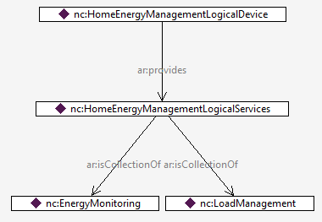
Home Energy Management Device
…is defined as something that provides HomeEnergyManagementLogicalServices
and that collection of services is defined below.
Providing the HomeEnergyManagementLogicalServices means that
you can perform all of the services in the collection.
Actor
ServiceComposition
Service

Slide 7
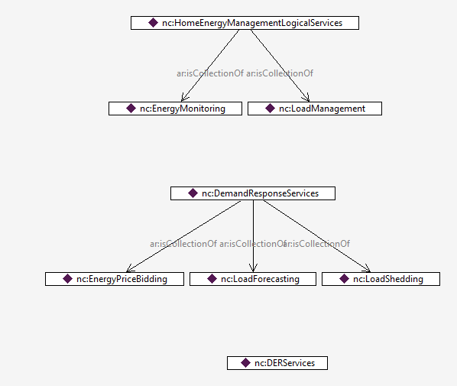
Some Logical Service Collections
ServiceComposition
Service
ServiceComposition
Service
ServiceComposition

Slide 8
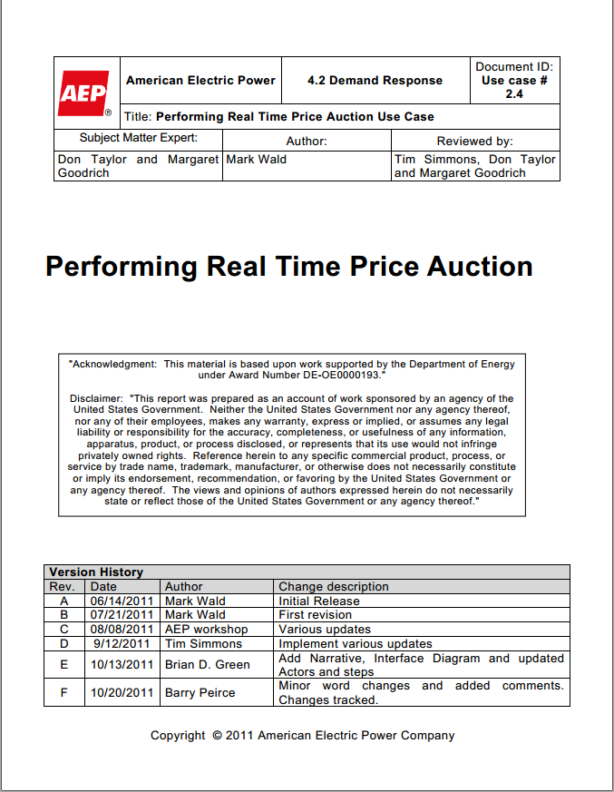
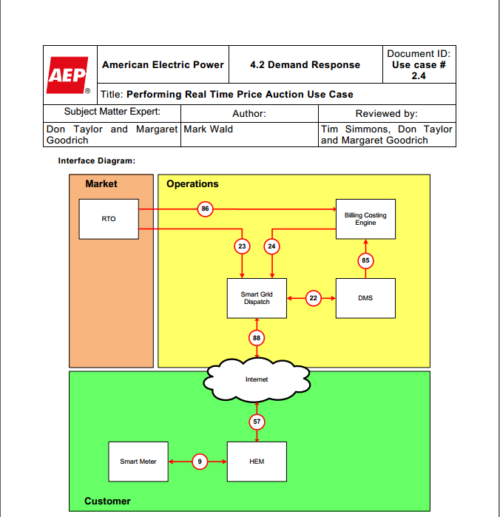
Mapping Use Case Terms
Let’s look at this term

Slide 9
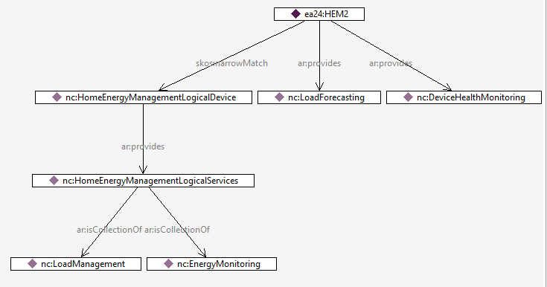
The HEM in the AEP/EPRI use case
…fulfills the definition of the HomeEnergyManagementLogicalDevice, plus
it provides the LoadForecasting service and DeviceHealthMonitoring service.
Actor
Actor (from use case)
Service
ServiceComposition
Service
Neutral Model

Slide 10
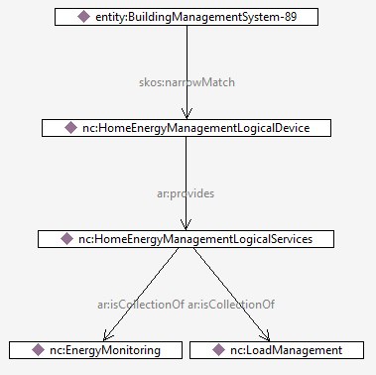
BuildingManagementSystem-89
…also fulfills the definition of the HomeEnergyManagementLogicalDevice, plus
it probably also provides other services.
Actor (from TC8 WG6)
How does this help? Because if you want to interface with something that is a
skos:narrowMatch to a HomeEnergyManagementLogicalDevice, then you are
guaranteed that it can perform LoadManagement (for example).
Neutral Model

Slide 11
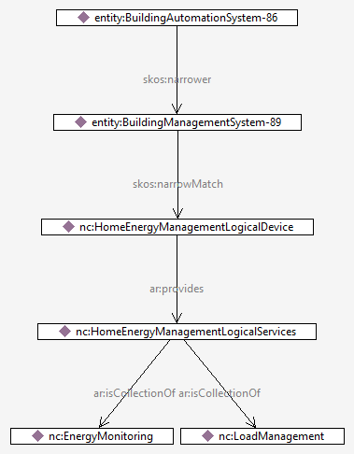
BuildingAutomationSystem-86
Actor (from CSWG NISTIR 7628)
Actor (from TC8 WG6)
…is also guaranteed to do LoadManagement, because in this example it can do everything BuildingManagementSystem-89 can do, plus possibly more.
Neutral Model

Slide 12
Implications
If we correctly categorize systems and services, we can begin to identify where interoperability is possible, and where there will be problems.

